Slide 1

Computer Organization and Architecture
Input Output Processors (IOP), A to D and D to A Convertor

Slide 2
Input Output Processors (IOP)
The DMA mode of data transfer reduces CPU’s overhead in handling I/O operations. It also allows parallelism in CPU and I/O operations.
Such parallelism is necessary to avoid wastage of valuable CPU time while handling I/O devices whose speeds are much slower as compared to CPU.
The concept of DMA operation can be extended to relieve the CPU further from getting involved with the execution of I/O operations.
This gives rises to the development of special purpose processor called Input-Output Processor (IOP).
The Input Output Processor (IOP) is just like a CPU that handles the details of I/O operations.
It is more equipped with facilities than those are available in typical DMA controller.
The IOP can fetch and execute its own instructions that are specifically designed to characterize I/O transfers.
In addition to the I/O – related tasks, it can perform other processing tasks like arithmetic, logic, branching and code translation.

Slide 3
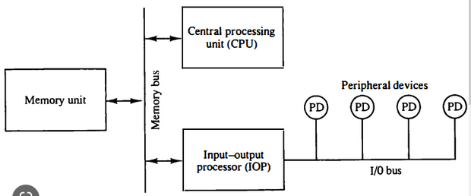
Block Diagram of IOP (Input output Processor)

Slide 4
IOP
The Input Output Processor is a specialized processor which loads and stores data into memory along with the execution of I/O instructions.
It acts as an interface between system and devices. It involves a sequence of events to executing I/O operations and then store the results into the memory.
Advantages –
The I/O devices can directly access the main memory without the intervention by the processor in I/O processor based systems.
It is used to address the problems that are arises in Direct memory access method.
Reduced processor workload: With an I/O processor, the main processor doesn’t have to deal with I/O operations, allowing it to focus on other tasks. This results in more efficient use of the processor’s resources and can lead to faster overall system performance.
Improved data transfer rates: Since the I/O processor can access memory directly, data transfers between I/O devices and memory can be faster and more efficient than with other methods.
Scalability: I/O processor based systems can be designed to scale easily, allowing for additional I/O processors to be added as needed. This can be particularly useful in large-scale data centers or other environments where the number of I/O devices is constantly changing.

Slide 5
Disadvantages of IOP
Disadvantages –
Cost: I/O processors can add significant cost to a system due to the additional hardware and complexity required. This can be a barrier to adoption, especially for smaller systems.
Increased complexity: The addition of an I/O processor can increase the overall complexity of a system, making it more difficult to design, build, and maintain. This can also make it harder to diagnose and troubleshoot issues.
Limited performance gains: While I/O processors can improve system performance by offloading I/O tasks from the main processor, the gains may not be significant in all cases. In some cases, the additional overhead of the I/O processor may actually slow down the system.
Synchronization issues: With multiple processors accessing the same memory, synchronization issues can arise, leading to potential data corruption or other errors.

Slide 6
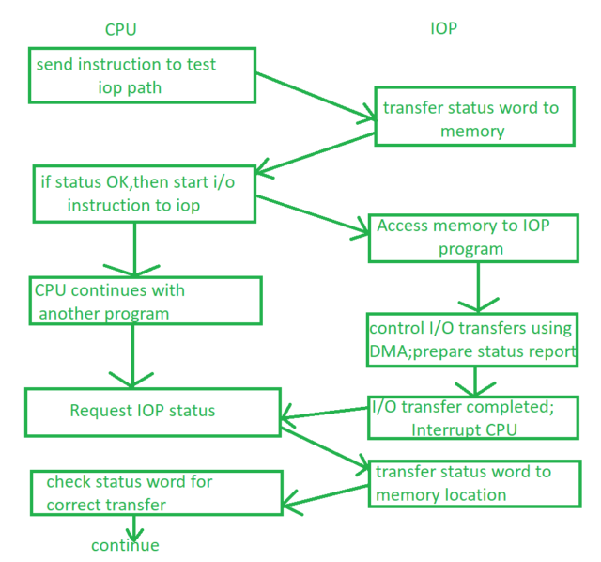
IOP –CPU Communication

Slide 7
IOP-CPU Communication
There is a communication channel between IOP and CPU to perform task which come under computer architecture.
This channel explains the commands executed by IOP and CPU while performing some programs.
The CPU do not executes the instructions but it assigns the task of initiating operations, the instructions are executed by IOP.
I/O transfer is instructed by CPU. The IOP asks for CPU through interrupt.
This channel starts by CPU, by giving “test IOP path” instruction to IOP and then the communication begins
IOP and CPU Whenever CPU gets interrupt from IOP to access memory, it sends test path instruction to IOP.
IOP executes and check for status, if the status given to CPU is OK, then CPU gives start instruction to IOP and gives it some control and get back to some another (or same) program, after that IOP is able to access memory for its program.

Slide 8
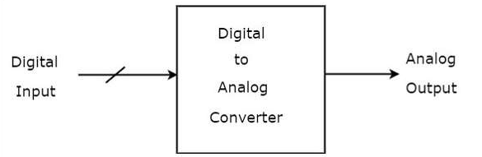
DAC (Digital to Analog Convertor)
A Digital to Analog Converter (DAC) converts a digital input signal into an analog output signal. The digital signal is represented with a binary code, which is a combination of bits 0 and 1.
A Digital to Analog Converter (DAC) consists of a number of binary inputs and a single output. In general, the number of binary inputs of a DAC will be a power of two.

Slide 9
Types of DAC (Digital to Analog Convertor)
There are two types of DACs
Weighted Resistor DAC
R-2R Ladder DAC

Slide 10
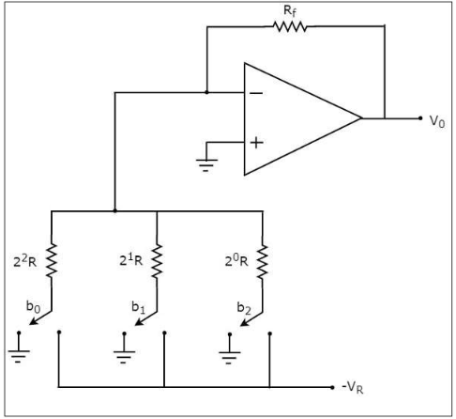
Weighted Resistor DAC
A weighted resistor DAC produces an analog output, which is almost equal to the digital (binary) input by using binary weighted resistors in the inverting adder circuit.

Slide 11
Weighted Resistor DAC
The bits of a binary number can have only one of the two values. i.e., either 0 or 1. Let the 3-bit binary input is b2b1b0.
Here, the bits b2 and b0 denote the Most Significant Bit (MSB) and Least Significant Bit (LSB) respectively.
The digital switches shown in the above figure will be connected to ground, when the corresponding input bits are equal to ‘0’.
Similarly, the digital switches shown in the above figure will be connected to the negative reference voltage, −VR when the corresponding input bits are equal to ‘1’.
In the circuit, the non-inverting input terminal of an op-amp is connected to ground. That means zero volts is applied at the non-inverting input terminal of op-amp.

Slide 12
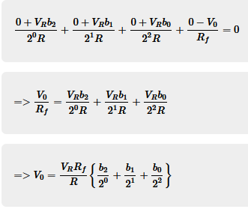
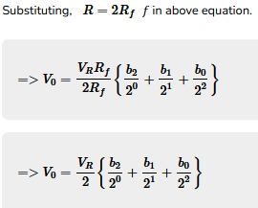
Weighted Resistor DAC
Nodal Analysis Equation

Slide 13

Weighted Resistor DAC
Nodal Analysis Equation
The above equation represents the output voltage equation of a 3-bit binary weighted resistor DAC. Since the number of bits are three in the binary (digital) input, we will get seven possible values of output voltage by varying the binary input from 000 to 111 for a fixed reference voltage, VR.
We can write the generalized output voltage equation of an N-bit binary weighted resistor DAC as shown below based on the output voltage equation of a 3-bit binary weighted resistor DAC.

Slide 14
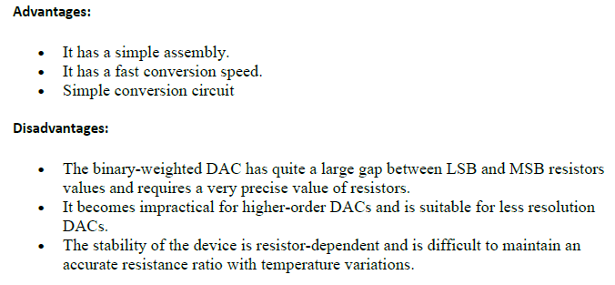
Weighted Resistor DAC
Advantages and Disadvantages

Slide 15
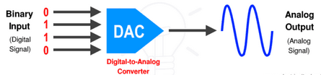
R-2R Ladder DAC
The R-2R Ladder DAC overcomes the disadvantages of a binary weighted resistor DAC. As the name suggests, R-2R Ladder DAC produces an analog output, which is almost equal to the digital (binary) input by using a R-2R ladder network in the inverting adder circuit.

Slide 16
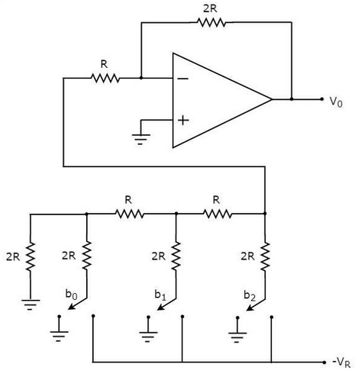
R-2R Ladder DAC

Slide 17
R-2R Ladder DAC
The bits of a binary number can have only one of the two values. i.e., either 0 or 1. Let the 3-bit binary input is b2b1b0.
Here, the bits b2 and b0 denote the Most Significant Bit (MSB) and Least Significant Bit (LSB) respectively.
The digital switches shown in the above figure will be connected to ground, when the corresponding input bits are equal to ‘0’.
Similarly, the digital switches shown in the above figure will be connected to the negative reference voltage, −VR when the corresponding input bits are equal to ‘1’.
In the circuit, the non-inverting input terminal of an op-amp is connected to ground. That means zero volts is applied at the non-inverting input terminal of op-amp.

Slide 18
R-2R Ladder DAC
Final Output Voltage Equation
The advantages of a R-2R Ladder DAC are as follows −
R-2R Ladder DAC contains only two values of resistor: R and 2R. So, it is easy to select and design more accurate resistors.
If more number of bits are present in the digital input, then we have to include required number of R-2R sections additionally
Due to the above advantages, R-2R Ladder DAC is preferable over binary weighted resistor DAC.

Slide 19
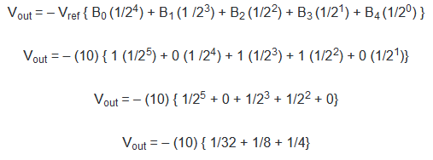

Numericals on DAC
Q.1 Convert a binary number of 01101 into an analog output where the v_{ref} = 10v.
Ans.
Here N=5 (No. of bits)

Slide 20
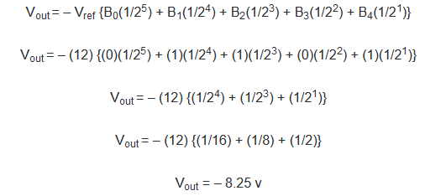
Numericals on DAC
Q.2 Convert a binary number of 10110 into an analog output where the v_{ref} = 12v
Ans.
Here N=5 (No. of bits)

Slide 21
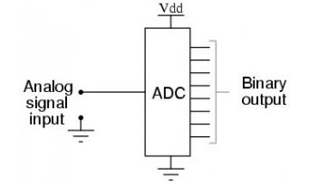
Analog to Digital Convertor (ADC)
A converter that is used to change or convert the analog signal to digital is known as an analog to digital converter or ADC converter.

Slide 22
ADC Types (as per syllabus)
Dual Slope ADC
Successive Approximation ADC

Slide 23
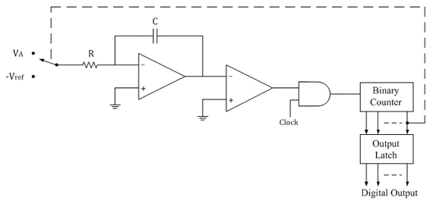
Dual Slope ADC
Circuit Diagram

Slide 24
Dual Slope ADC (Cont…)
In dual slope type ADC, the integrator generates two different ramps, one with the unknown analog input voltage VA and another with a known reference voltage –Vref. Hence it is called a s dual slope A to D converter.
Operation:
The binary counter is initially reset to 0000; the output of integrator reset to 0V and the input to the ramp generator or integrator is switched to the unknown analog input voltage VA.
The analog input voltage VA is integrated by the inverting integrator and generates a negative ramp output.
The output of comparator is positive and the clock is passed through the AND gate. This results in counting up of the binary counter.

Slide 25
Dual Slope ADC (Cont…)
The negative ramp continues for a fixed time period t1, which is determined by a count detector for the time period t1. At the end of the fixed time period t1, the ramp output of integrator is given by
VS=-VA/RC×t1
When the counter reaches the fixed count at time period t1, the binary counter resets to 0000 and switches the integrator input to a negative reference voltage –Vref.
Now the ramp generator starts with the initial value –Vs and increases in positive direction until it reaches 0V.
The conversion cycle is said to be completed and the positive ramp voltage is given by
VS=Vref/RC×t2
Where Vref & RC are constants and time period t2 is variable.

Slide 26
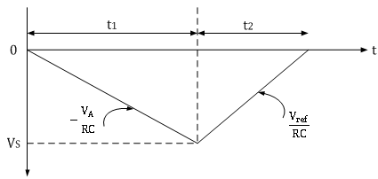
Dual Slope ADC (Cont…)
The dual ramp output waveform is shown below.

Slide 27
Dual Slope ADC (Cont…)
Since ramp generator voltage starts at 0V, decreasing down to –Vs and then increasing up to 0V, the amplitude of negative and positive ramp voltages can be equated as follows.
Vref/RC×t2=-VA/RC×t1
t2= --t1×VA/Vref
VA=-Vref×t1/t2
Thus the unknown analog input voltage VA is proportional to the time period t2, because Vref is a known reference voltage and t1 is the predetermined time period.
The actual conversion of analog voltage VA into a digital count occurs during time t2.
The binary counter gives corresponding digital value for time period t2.
The clock is connected to the counter at the beginning of t2 and is disconnected at the end of t2.
Thus the counter counts digital output as
Digital output=(counts/sec) t2
Digital output=(counts/sec)[t1×VA/Vref ]

Slide 28
2. Successive Approximation type ADC
Successive Approximation type ADC is the most widely used and popular ADC method.
The conversion time is maintained constant in successive approximation type ADC, and is proportional to the number of bits in the digital output.
The basic principle of this type of A/D converter is that the unknown analog input voltage is approximated against an n-bit digital value by trying one bit at a time, beginning with the MSB.
Operation:
(1) The MSB is initially set to 1 with the remaining three bits set as 000. The digital equivalent voltage is compared with the unknown analog input voltage.
(2) If the analog input voltage is higher than the digital equivalent voltage, the MSB is retained as 1 and the second MSB is set to 1. Otherwise, the MSB is set to 0 and the second MSB is set to 1. Comparison is made as given in step (1) to decide whether to retain or reset the second MSB.

Slide 29
2. Successive Approximation type ADC (Cont…)
The above steps are more accurately illustrated with the help of an example.
Let us assume that the 4-bit ADC is used and the analog input voltage is VA = 11 V.
when the conversion starts, the MSB bit is set to 1.
Now VA = 11V > VD = 8V = [1000]
Since the unknown analog input voltage VA is higher than the equivalent digital voltage VD, as discussed in step (2), the MSB is retained as 1 and the next MSB bit is set to 1 as follows
VD = 12V = [1100]

Slide 30
2. Successive Approximation type ADC (Cont…)
Now VA = 11V < VD = 12V = [1100]
Here now, the unknown analog input voltage VA is lower than the equivalent digital voltage VD. As discussed in step (2), the second MSB is set to 0 and next MSB set to 1 as
VD = 10V = [1010]
Now again VA = 11V > VD = 10V = [1010]
Again as discussed in step (2) VA>VD, hence the third MSB is retained to 1 and the last bit is set to 1. The new code word is
VD = 11V = [1011] Now finally VA = VD , and the conversion stops.

Slide 31
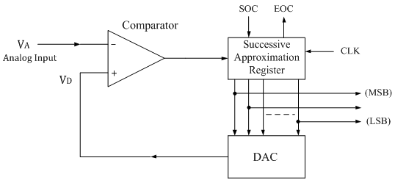
2. Successive Approximation type ADC (Cont…)
The functional block diagram of successive approximation type of ADC is shown below.

Slide 32
2. Successive Approximation type ADC (Cont…)
It consists of a successive approximation register (SAR), DAC and comparator.
The output of SAR is given to n-bit DAC. The equivalent analog output voltage of DAC, VD is applied to the non-inverting input of the comparator.
The second input to the comparator is the unknown analog input voltage VA. The output of the comparator is used to activate the successive approximation logic of SAR.
When the start command is applied, the SAR sets the MSB to logic 1 and other bits are made logic 0, so that the trial code becomes 1000.
SOC- Start of Conversion
EOC-End of Conversion
Advantages: 1 Conversion time is very small. 2 Conversion time is constant and independent of the amplitude of the analog input signal VA.
Disadvantages: 1 Circuit is complex. 2 The conversion time is more compared to flash type ADC.

Slide 33
Thank You

Slide 34
Assignment
Q. 1 Address Sequencing (Lect. 18 in CHO)
Q. 2 Data Transfer and manipulation (Lect. No. 25 in CHO)
Q. 3 Asynchronous Data transfer (Lect. 36 in CHO)
Q.4 Modes of Transfer (Lect. 37 in CHO)

